Slide 1
Day -1
Snowflake Training

Slide 2
What is Snowflake?
Snowflake’s Data Cloud is powered by an advanced data platform provided as Software-as-a-Service (SaaS). Snowflake enables data storage, processing, and analytic solutions that are faster, easier to use, and far more flexible than traditional offerings.
The Snowflake data platform is not built on any existing database technology or “big data” software platforms such as Hadoop. Instead, Snowflake combines a completely new SQL query engine with an innovative architecture natively designed for the cloud. To the user, Snowflake provides all of the functionality of an enterprise analytic database, along with many additional special features and unique capabilities.
Snowflake is a true SaaS offering. More specifically: (Data Platform as a cloud service)
There is no hardware (virtual or physical) to select, install, configure, or manage.
There is virtually no software to install, configure, or manage.
Ongoing maintenance, management, upgrades, and tuning are handled by Snowflake.
Snowflake runs completely on cloud infrastructure.
All components of Snowflake’s service (other than optional command line clients, drivers, and connectors), run in public cloud infrastructures.
Snowflake uses virtual compute instances for its compute needs and a storage service for persistent storage of data.
Snowflake cannot be run on private cloud infrastructures (on-premises or hosted).
Snowflake is not a packaged software offering that can be installed by a user.
Snowflake manages all aspects of software installation and updates.
Decoupled compute and storage (scaled compute does not need scaled storage).

Slide 3
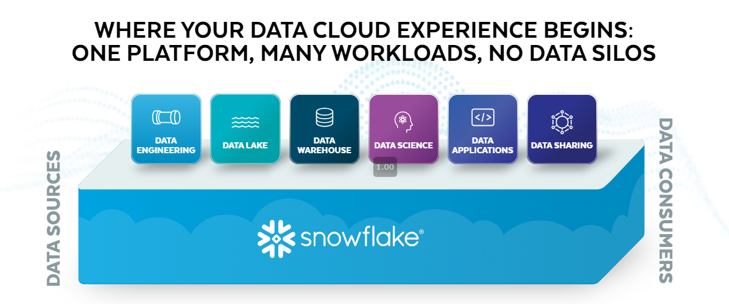

Slide 4
Why Snowflake?
Snowflake enables data storage, processing, and analytic solutions that are faster, easier to use, and far more flexible than traditional offerings.
A single platform – single source for all data
Secure and governed access to all data (zero-copy cloning)
Near-zero maintenance
Unlimited scalability
Semi-structured data support
Extensive partner ecosystem
Cost effective

Slide 5
Snowflake Editions
Standard Edition
Enterprise Edition
Business Critical Edition
Virtual Private Snowflake (VPS)
Snowflake offers multiple editions to choose from, ensuring that your usage fits your organization’s specific requirements. Each successive edition builds on the previous edition through the addition of edition-specific features and/or higher levels of service. And, as your organization’s needs change and grow, changing editions is easy

Slide 6
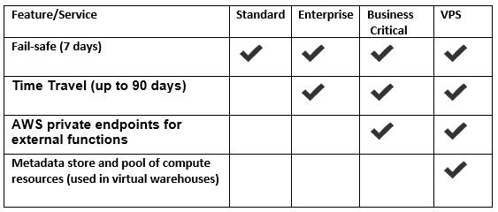
Some features of Snowflake Editions

Slide 7
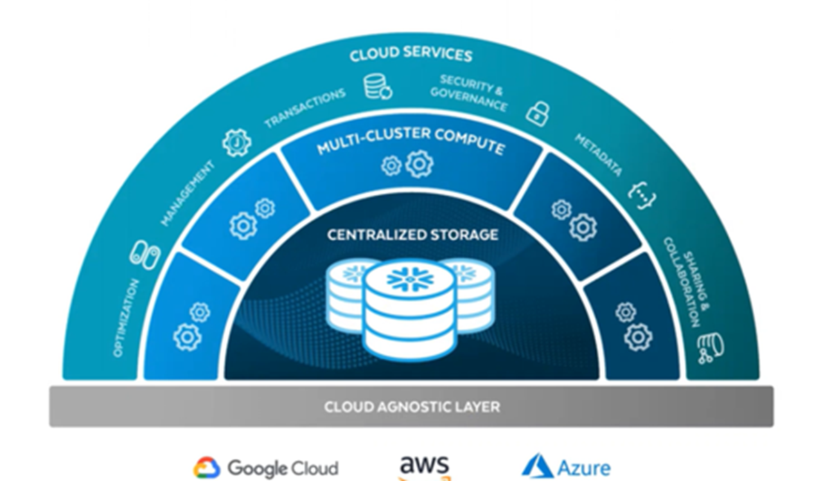
Snowflake Architecture
Snowflake’s architecture is a hybrid of traditional shared-disk and shared-nothing database architectures.
Outermost Layer : Services layer (authentication, infrastructure management, governance, metadata, optimization)
Middle Layer: Multi-cluster compute layer (takes place in the virtual warehouses)
Innermost Layer: Storage layer (consists of micro-partitions)

Slide 8
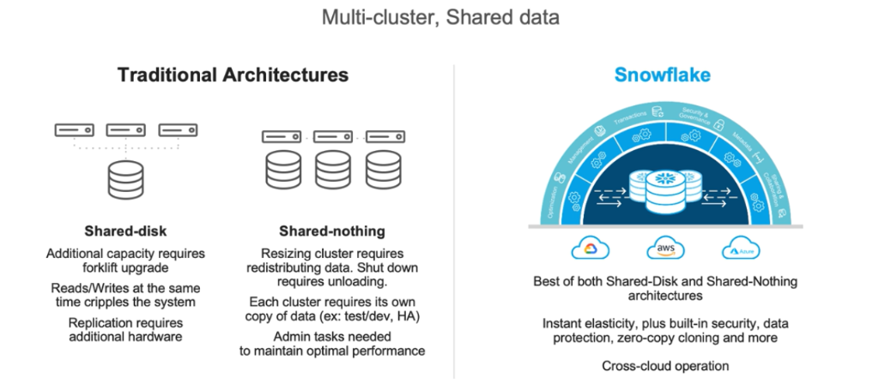
Shared-nothing and Shared-disk

Slide 9
Snowflake Architecture
Snowflake’s architecture is a hybrid of traditional shared-disk and shared-nothing database architectures.
Outermost Layer : Services layer (authentication, infrastructure management, governance, metadata, optimization)
Middle Layer: Multi-cluster compute layer (takes place in the virtual warehouses)
Innermost Layer: Storage layer (consists of micro-partitions)
Micro-Partition:
All data in Snowflake tables is automatically divided into micro-partitions, which are contiguous units of storage.
Data is stored in a columnar fashion in these micro-partitions.
Each micro-partition contains between 50 MB and 500 MB of uncompressed data.
This size and structure allows for extremely granular pruning of very large tables, which can be comprised of millions, or even hundreds of millions, of micro-partitions.

Slide 10
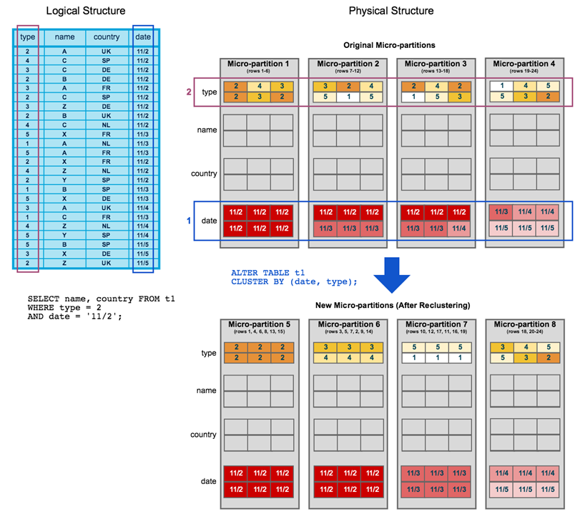
Data Clustering using Micro-Partitions

Slide 11
Snowflake Account Creation

Slide 12
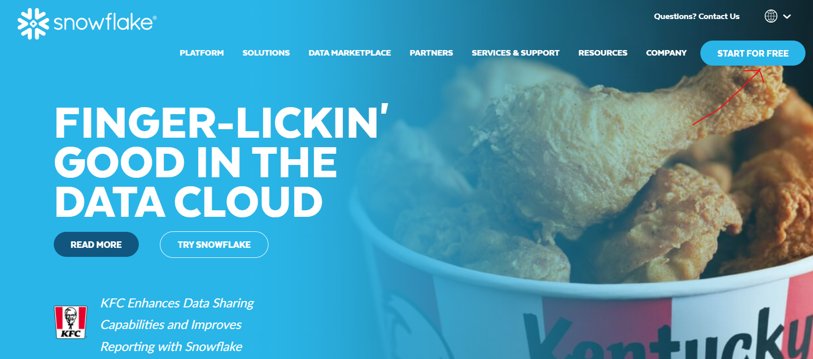
Snowflake Account Creation
Step -1: Go to Snowflake official website https://www.snowflake.com
Step -2: Click on START FOR FREE on top right side it will redirect to sign up page

Slide 13
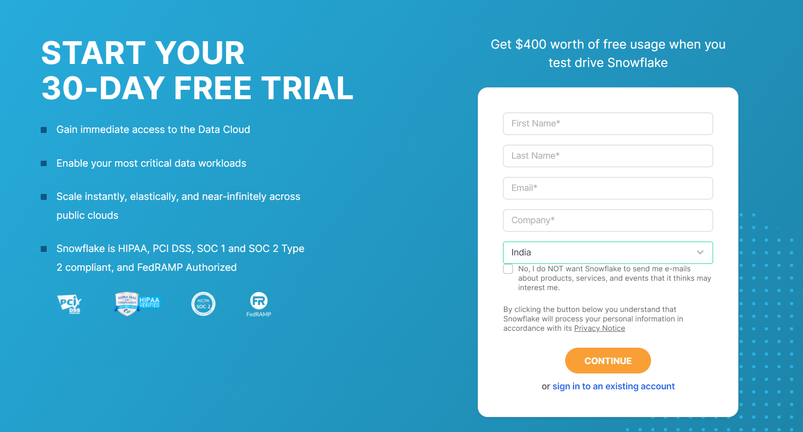
Snowflake Account Creation

Slide 14
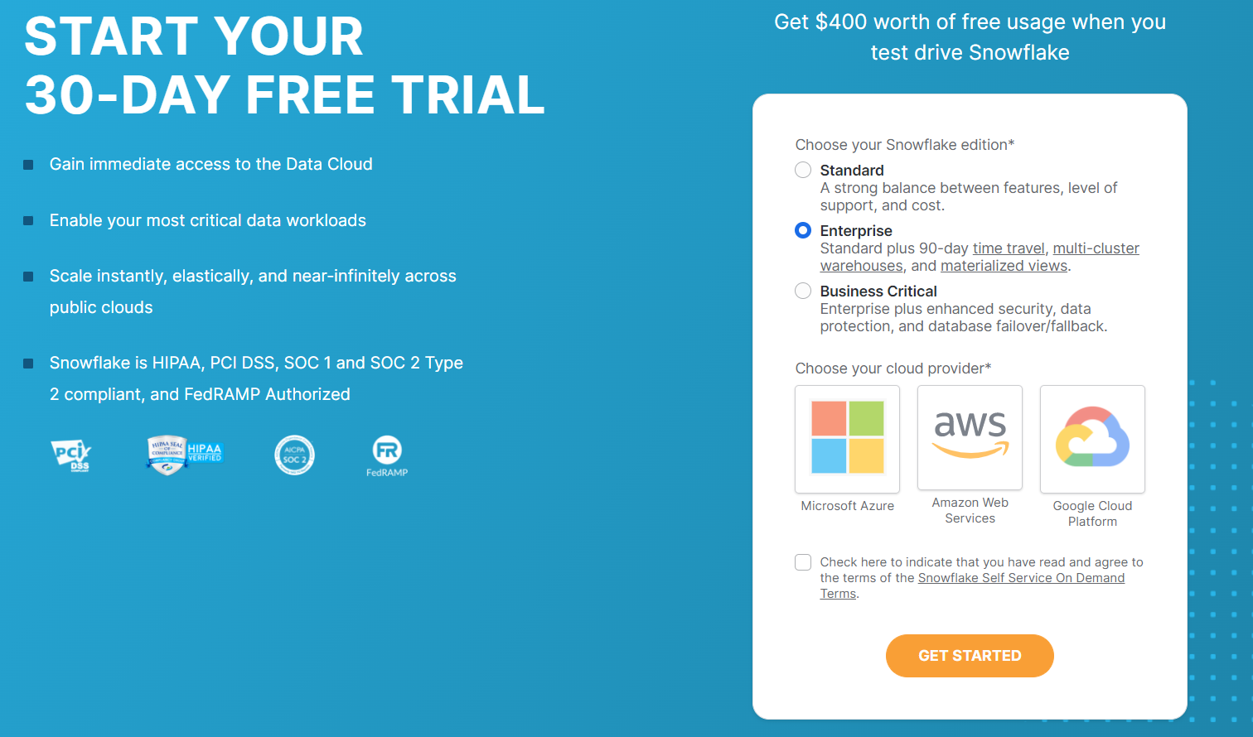
Snowflake Account Creation

Slide 15
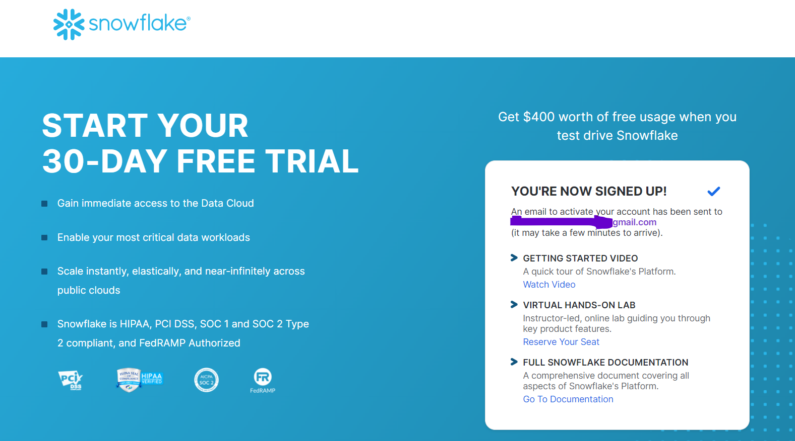
Snowflake Account Creation

Slide 16
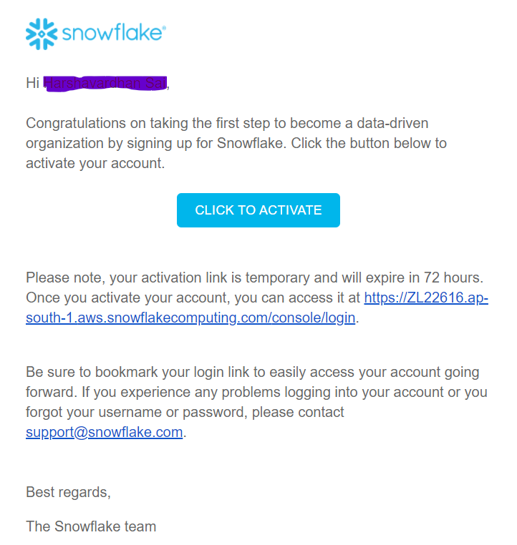
Snowflake Account Creation
Step -5: Click on activate for activation

Slide 17
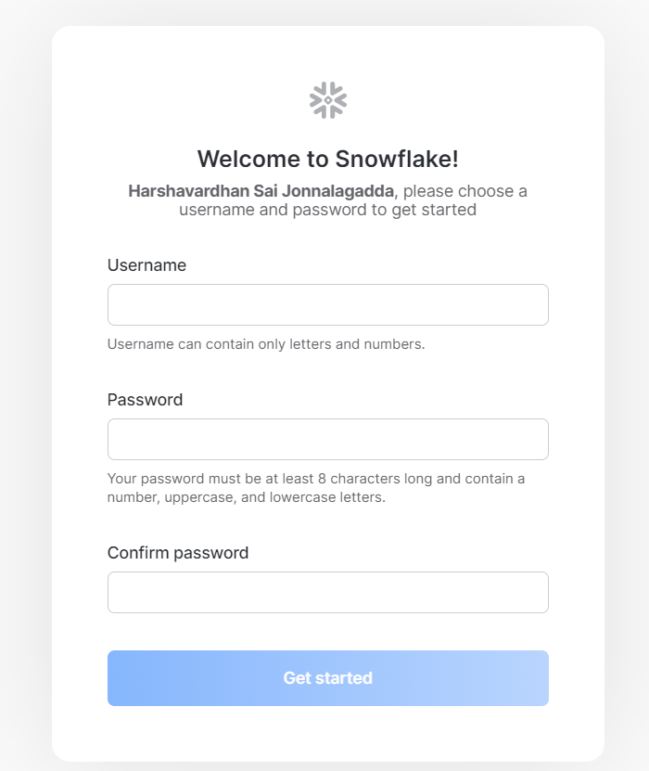
Snowflake Account Creation
Step -6: Create username and password and click on get started.

Slide 18
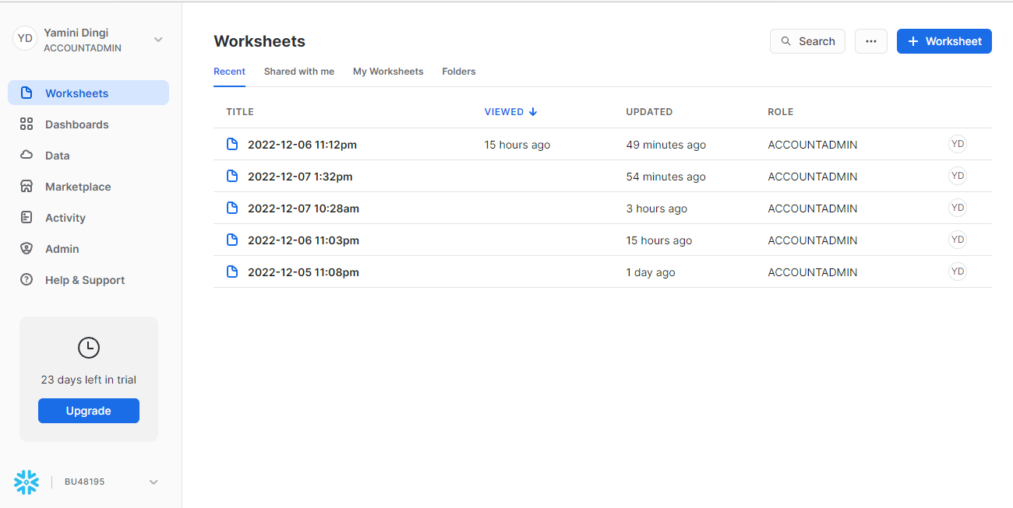
Snowflake Account Creation

Slide 19
SPN Account creation

Slide 20
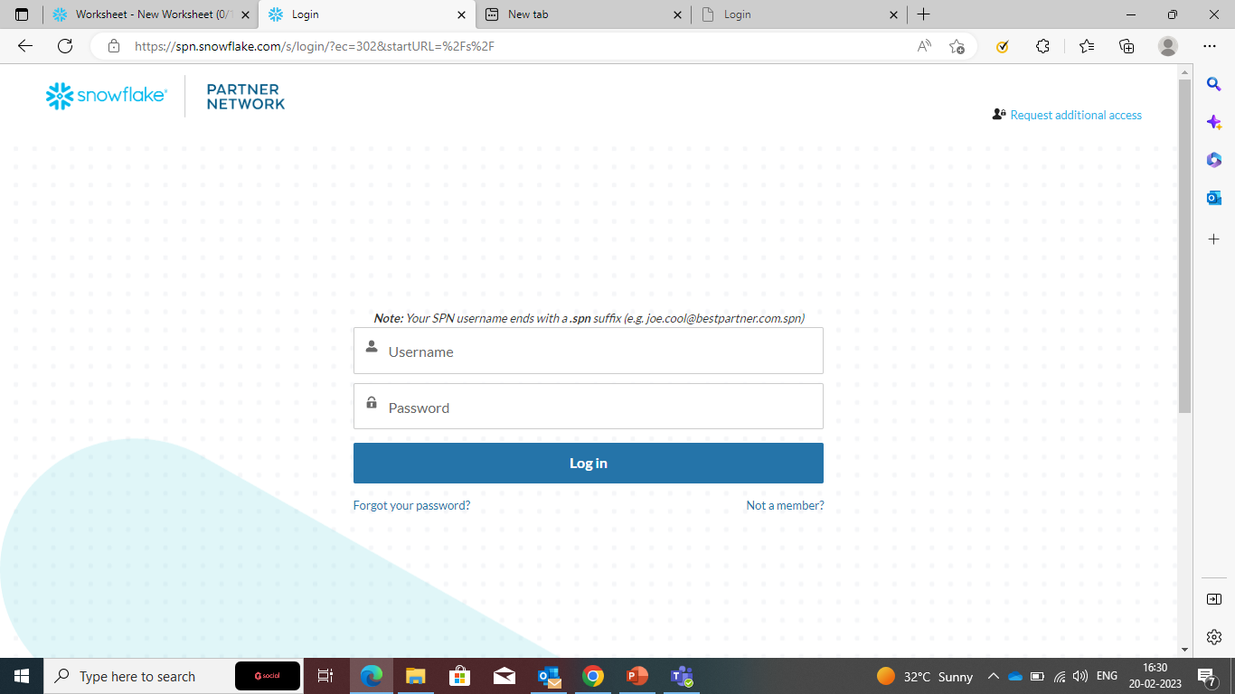
Spn account creation
1.Log on to Login (snowflake.com)
2.Click on ‘Not a member?’

Slide 21
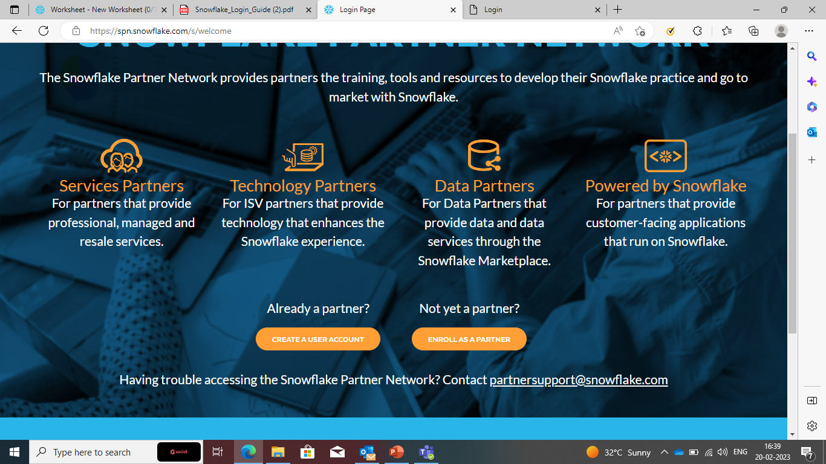
Spn account creation
3. Click on ‘Create a user account’

Slide 22
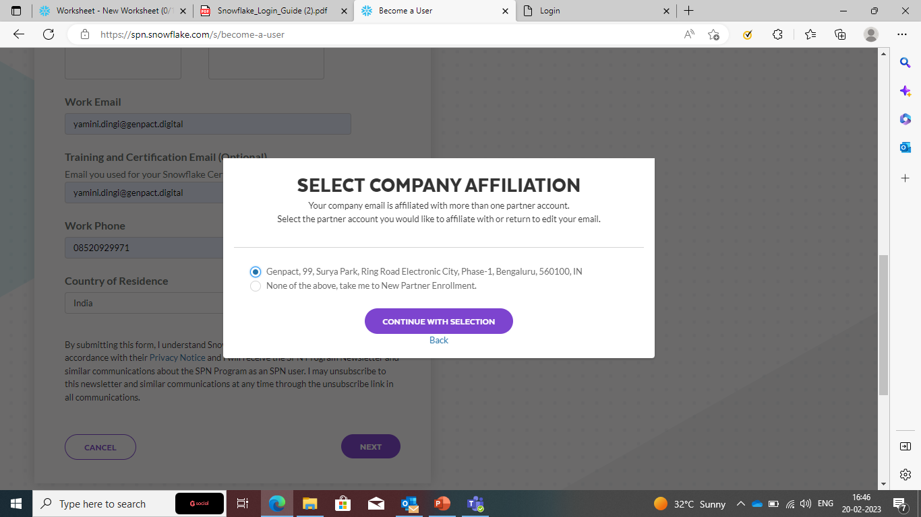
Spn account creation
4. Fill out all the details
5. Select the Genpact affiliation option, continue with selection and submit

Slide 23
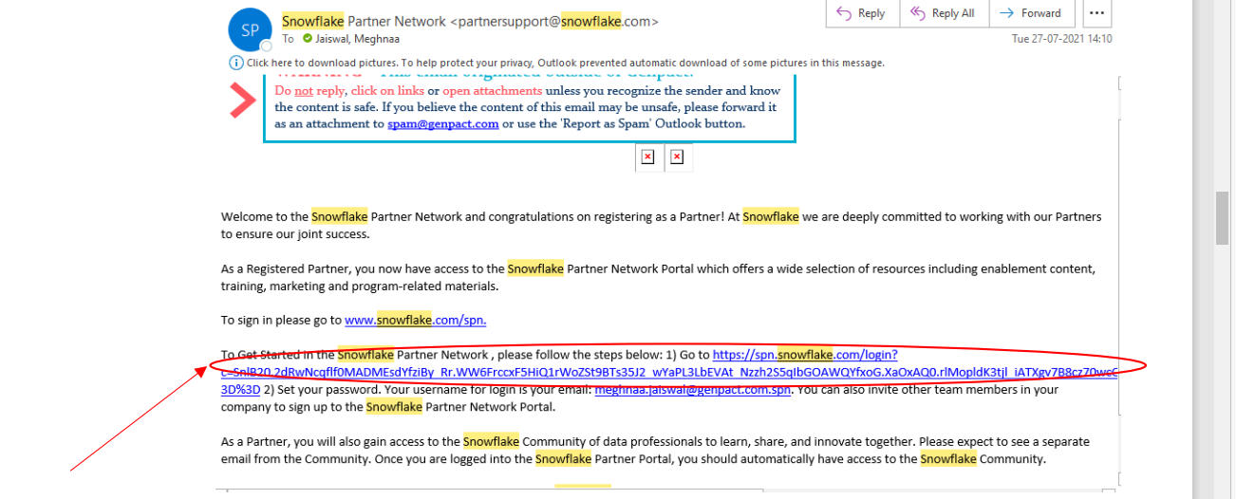
Spn account creation
6. You will get a mail to finish registration on your registered email id. Click on the link after ‘go to’ and change your password.

Slide 24
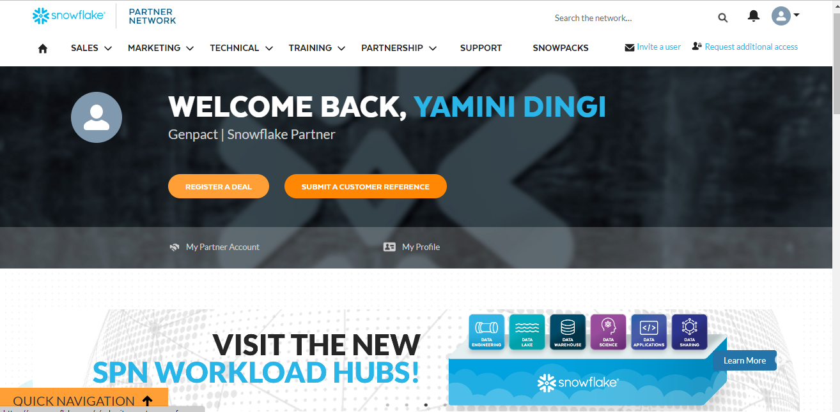
Spn account creation
8.After changing password,sign in again with the username that you got in another mail
And click login and page like this appear.

Slide 25
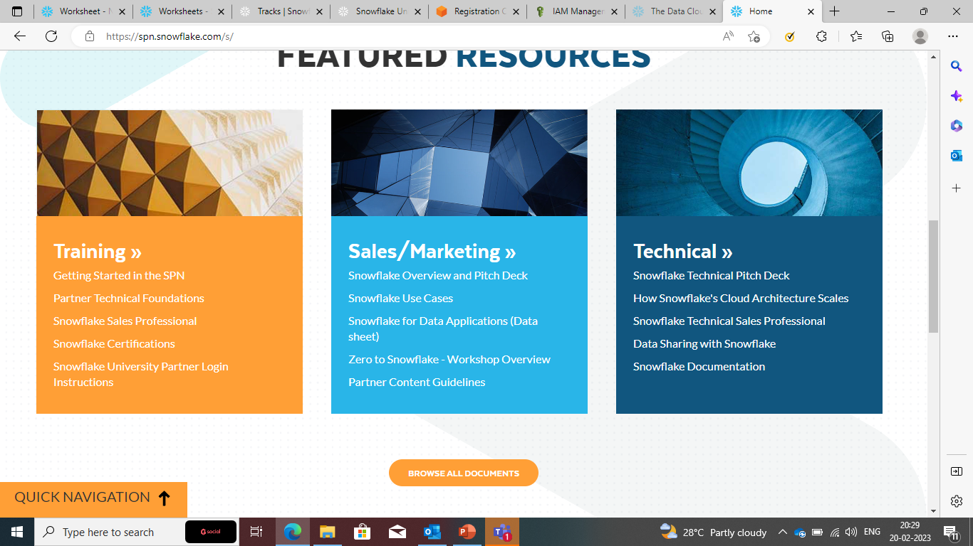
Spn account creation
9.After that before page appears scroll down under technical click on snowflake technical sales professional

Slide 26
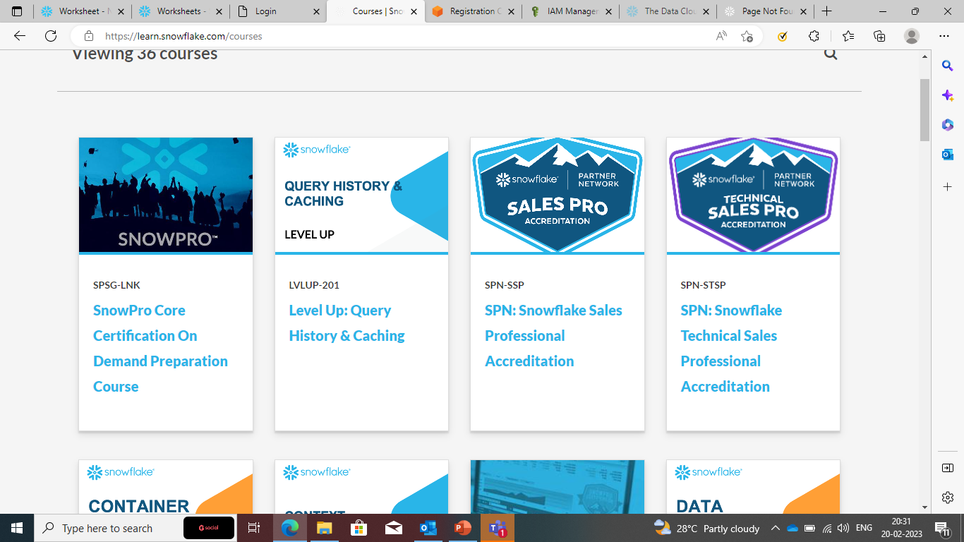
Spn account creation
10.After clicking on that you have to again click on sign in.
11.After sign in choose explore courses you will get all the courses here.

Slide 27
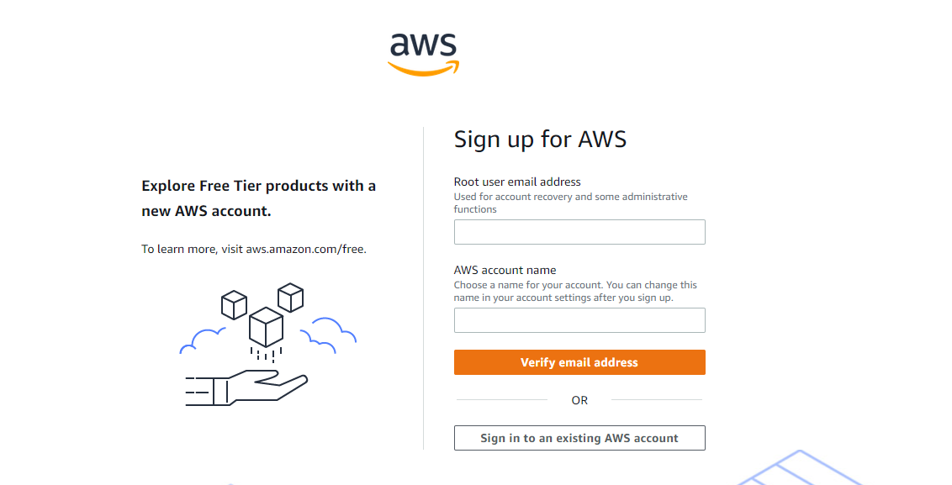
AWS Fundamentals
AWS Account Creation
Step -1: Go to AWS website https://portal.aws.amazon.com/billing/signup#/start/email
Step -2: Enter Email and account name and click on verify Email Address

Slide 28
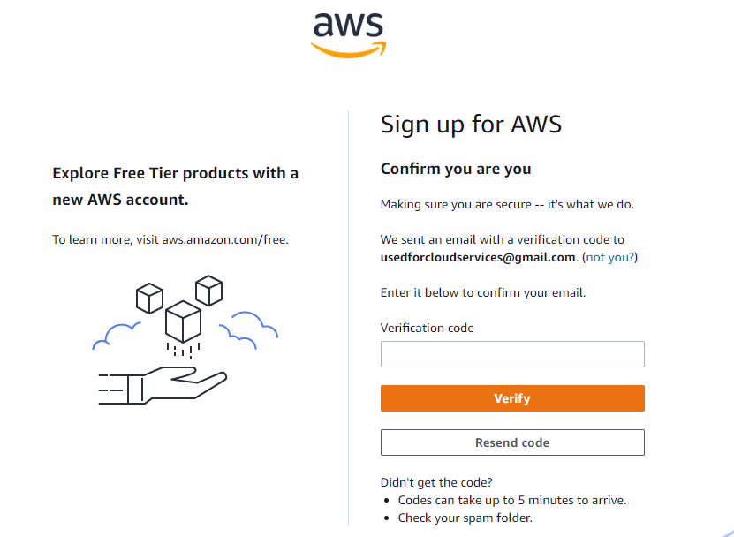
AWS Account Creation
Step -3: Verify your email address

Slide 29
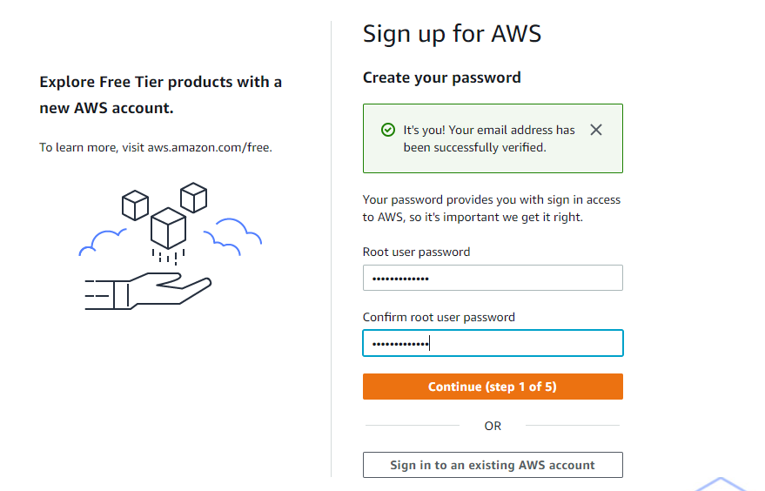
AWS Account Creation
Step -4: Create a Password

Slide 30
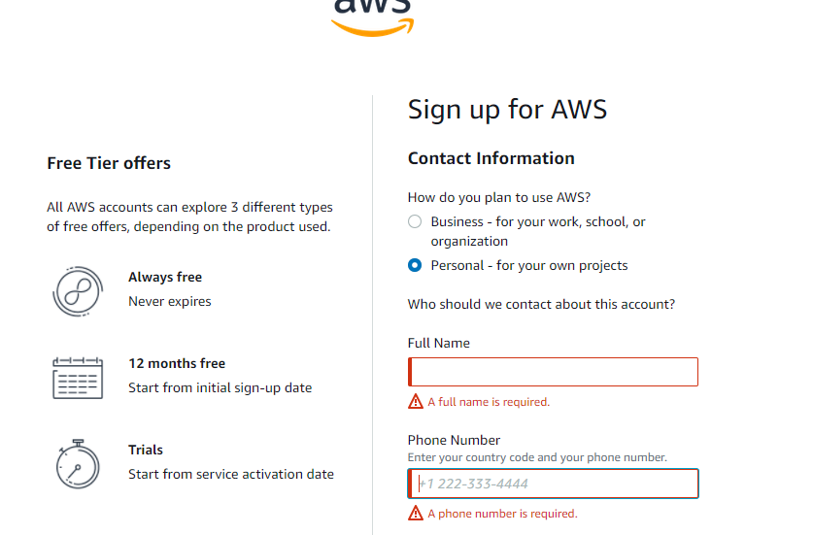
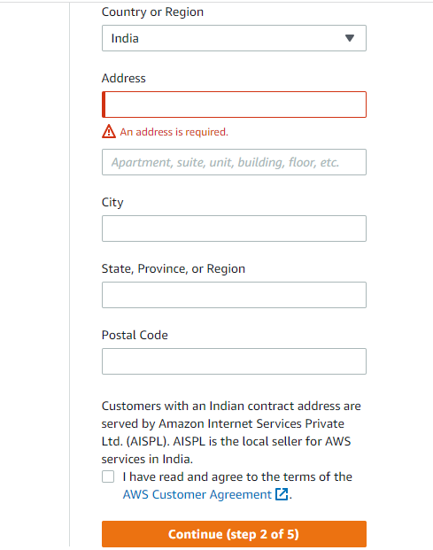
AWS Account Creation
Step -5: Select used for Personal Projects and provide billing address

Slide 31
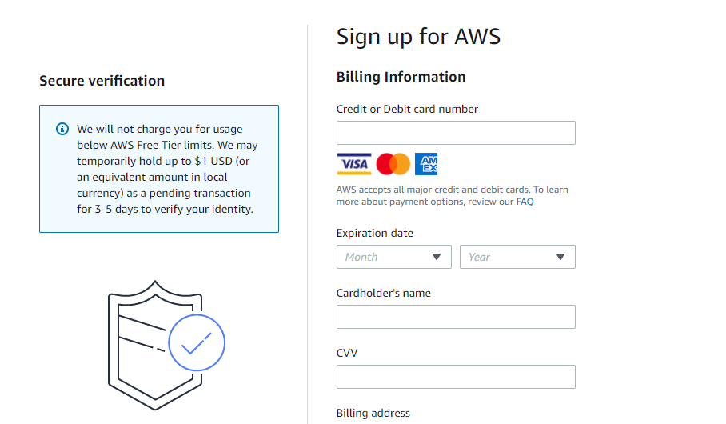
AWS Account Creation
Step -6: provide debit Card details

Slide 32
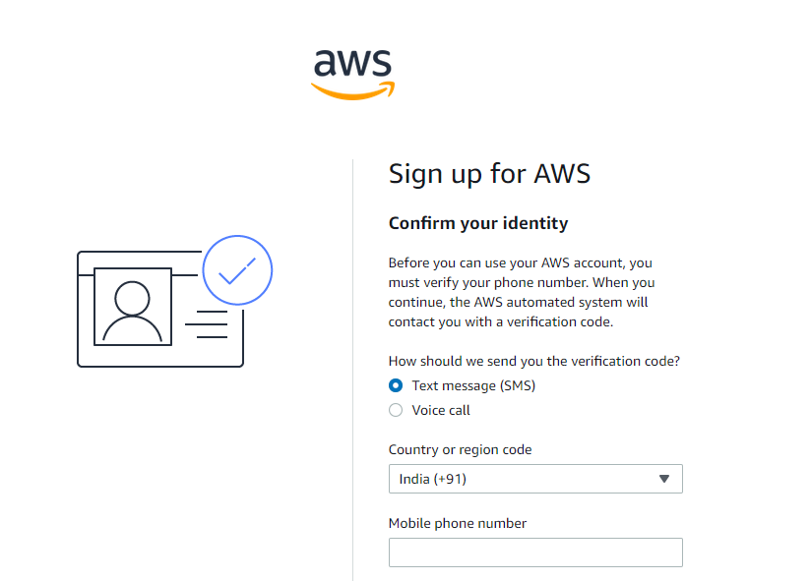
AWS Account Creation
Step -7: verify your mobile number

Slide 33
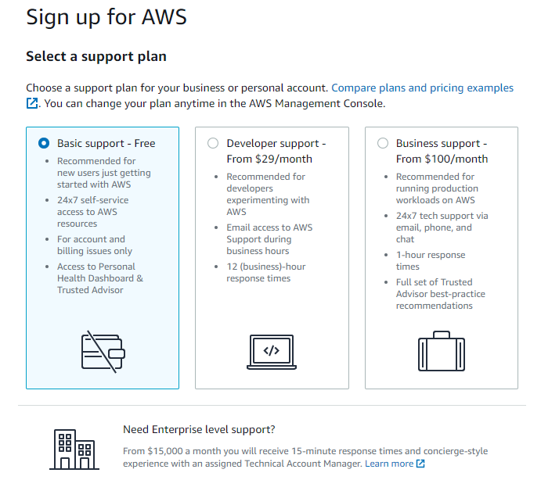
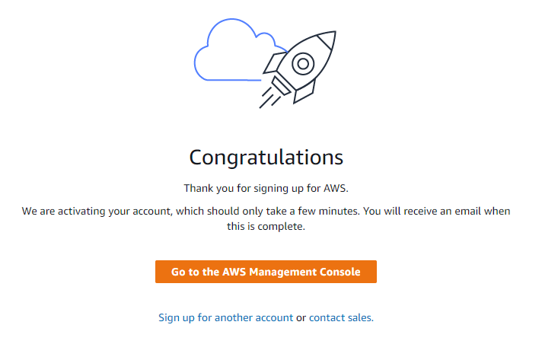
AWS Account Creation
Step -8: Select Basic support plan and click on complete sign up and go to AWS console

Slide 34
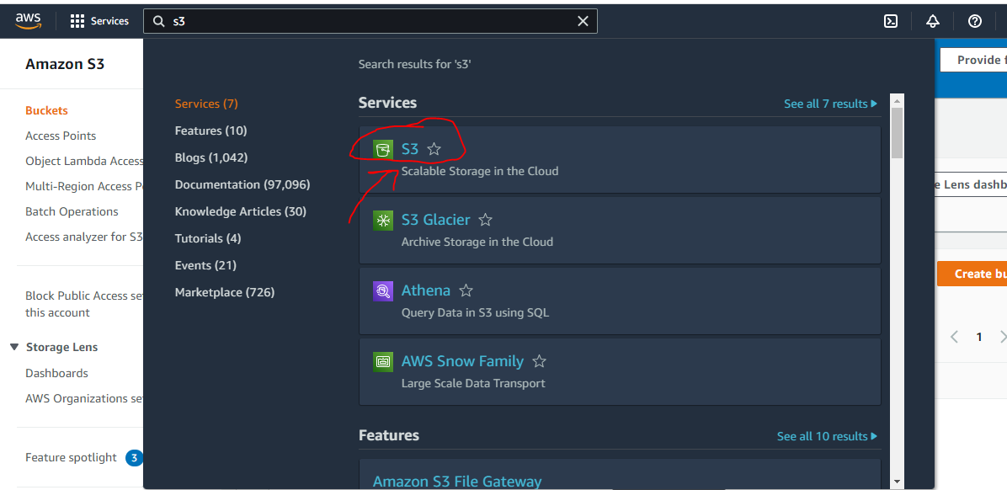
AWS Fundamentals
Simple Storage Service – S3
Step -1: Login to AWS account
Step -2: Search for S3

Slide 35
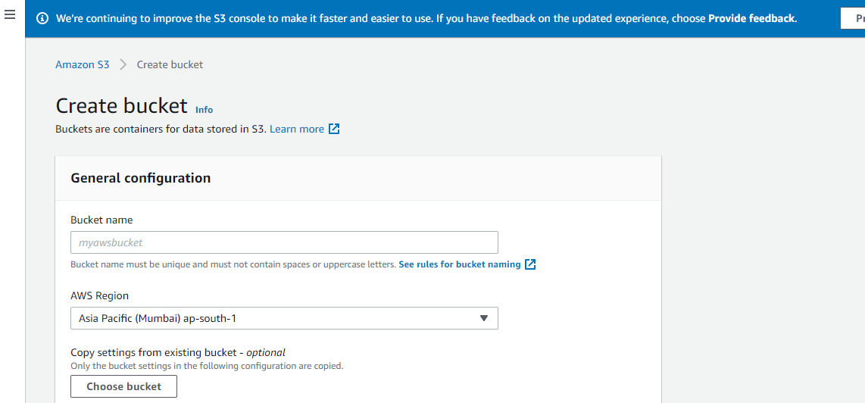
AWS Fundamentals
Simple Storage Service – S3
Step -4: Fill the general information. You can leave the default setting selected and then click on Create Bucket.​

Slide 36
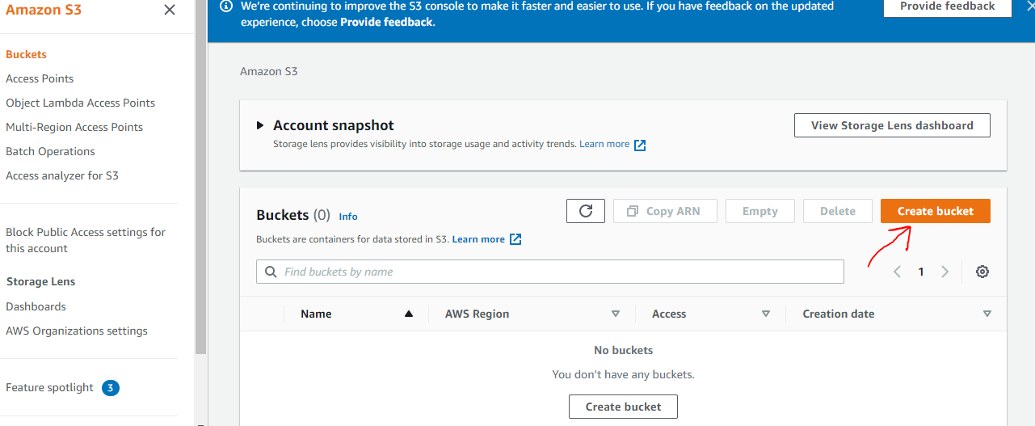
AWS Fundamentals
Simple Storage Service – S3
Step -3: Click on Create Bucket

Slide 37
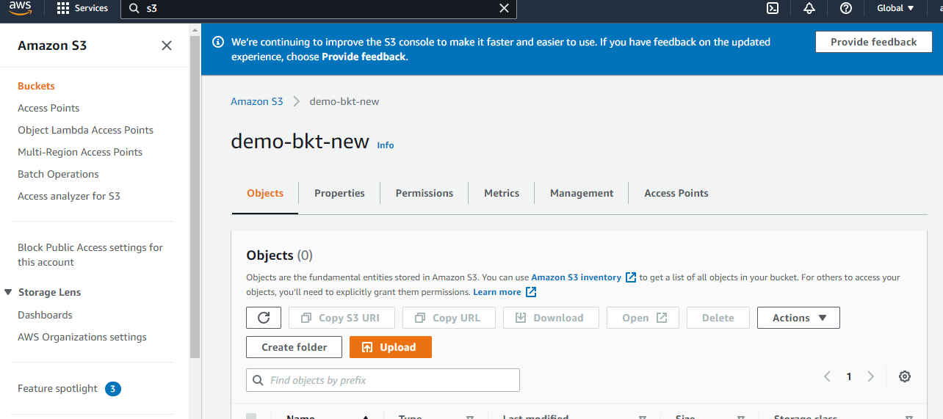
AWS Fundamentals
Simple Storage Service – S3
Step -5: New Bucket is created. You can upload your files now.​

Slide 38

AWS Fundamentals
Identity and Access Management – IAM
IAM allows you to Manage Users, Groups and their Level of access to the AWS Services.
Users – End Users(people)
Groups – Collection of Users, under one set of Permissions.
Policies – Set of Permissions
Roles – We can Create roles and assign them to AWS resources
IAM is Universal. It does not apply to regions at this time
The root account” is simply the account created when you first setup your AWS Account. It has complete Admin access.
New Users are assigned Access Key ID & Secret Access Key when first created.

